Slide 1
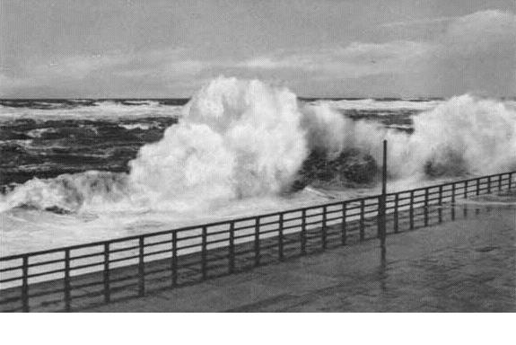
Liquid Handling with the Microlab STAR

Slide 2
Overview
Relevant physical properties
Air displacement pipetting
MAD
Liquid handling control with the ML STAR
  Method settings
  Liquid classes
Liquid class determination

Slide 3
Relevant Physical Properties
Liquid density ⇒ liquid flow
Viscosity ⇒ liquid flow
Surface tension ⇒ wetting & adhesion
Vapor pressure ⇒ saturation
Tip geometry ⇒ liquid flow & adhesion
Surface energy ⇒ wetting & adhesion

Slide 4
Air Displacement Pipetting
Plunger
Well known from handheld
Pipette relatively large air gap
Low risk of carry over
Numerous adjustable parameters
Highly flexible but very complex
Channel
Air Gap
Tip
Liquid
Transport Air

Slide 5
Physics of Air Displacement Pipetting
Plunger
Channel
V_{plunger}=V_{liquid}+V_{hydr}+V_{evap}+V_{temp}+V_{ads}
⇒ Correction
Correction curve is part of liquid class
Air Gap
Tip
Liquid
Transport Air

Slide 6
Monitored Air Displacement
Pressure-Sensor
Channel: No Liquid
Tip
Air Gap
Liquid

Slide 7
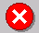
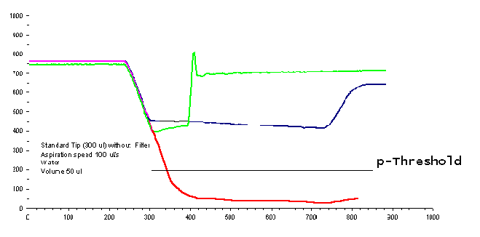
Monitored Air Displacement
p(t)
Cup empty on aspiration
Normal aspiration
Tip blocked on aspiration (clot)
t/ms
Ultimate process stability (>10μl)
Can adjust p-Threshold using HSLML_STARLib.hsl

Slide 8
Liquid Handling Control
Method settings
  Aspiration and dispense modes
  Target volumes
  LLD and mixing settings
Liquid classes
  Pipetting parameters
  Correction values

Slide 9
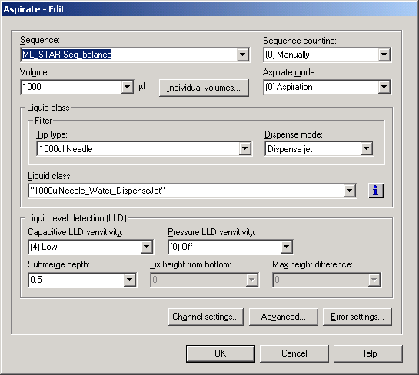
The User SW Aspiration Dialog
Aspiration mode
Target volume
Liquid class
LLD settings

Slide 10
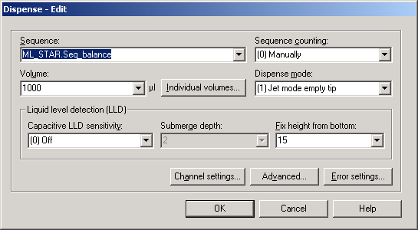
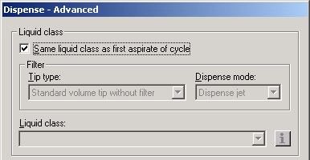
The Dispense Step
Option to choose different liquid class

Slide 11
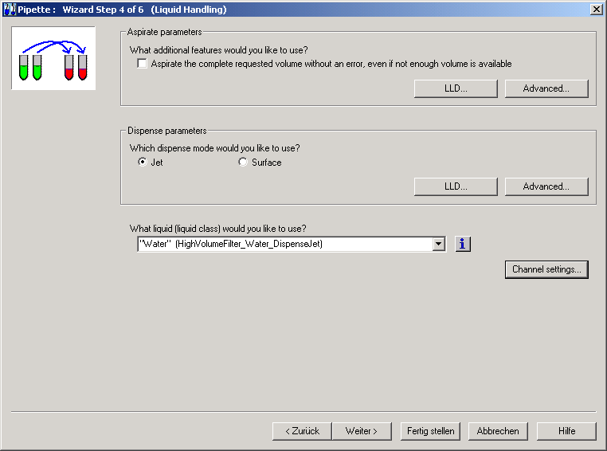
Liquid Handling in SMART Steps

Slide 12
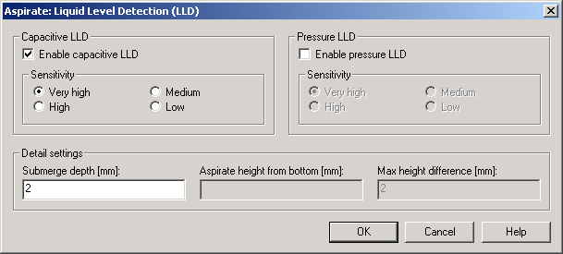
Liquid Handling in SMART Steps

Slide 13
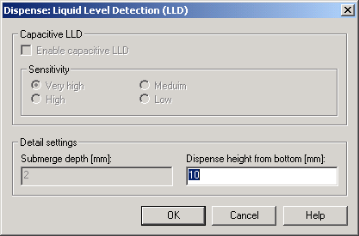
Liquid Handling in SMART Steps

Slide 14
Aspiration/Dispense Modes
• Aspiration and dispense steps have different modes.
• The mode determines which liquid class parameters are active.
• Usually one aspiration/dispense cycle uses only one liquid class.
Aspiration Modes:
(0) Aspiration
(1) Consecutive Aspiration
(2) Aspirate All
Dispense Modes:
(0) Jet Dispense Part Volume
(1) Jet Dispense Empty Tip
(2) Surface Dispense Part Volume
(3) Surface Dispense Empty Tip

Slide 15
Why Have Liquid Classes?
All relevant pipetting parameters are stored in a single file.
Method programmer needs only to specify target volume, aspiration/dispense modes, and liquid class in the method.
Installed liquid class library provides sets of pipetting parameters for common applications.

Slide 16
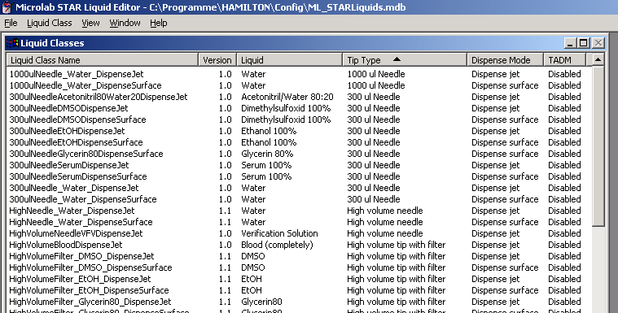
Liquid Editor

Slide 17
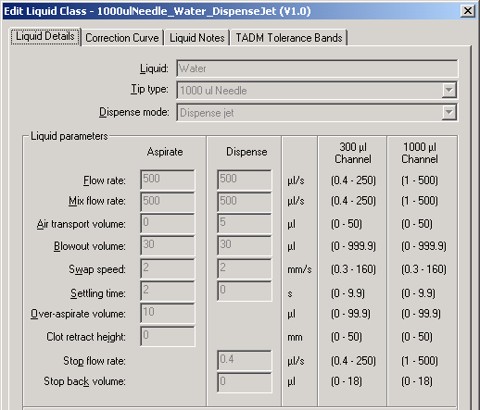
Liquid Class Parameters

Slide 18
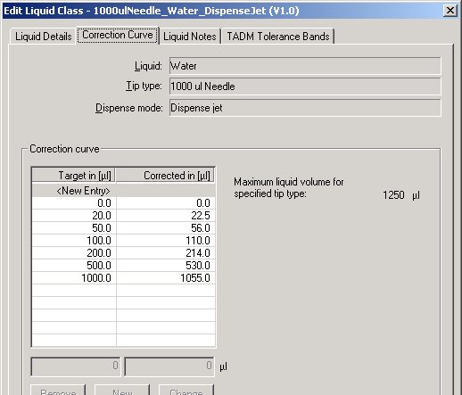
Liquid Class Correction Curve

Slide 19
Liquid Class Dependencies
Liquid
Tip or Needle Type
Dispense Mode

Slide 20
Tip and Needle Types
10μl, 50μl, 300μl and 1000μl conductive (black) disposable tips, filtered and unfiltered
10μl, 50μl, 300μl and 1000μl non-conductive (clear) disposable tips, unfiltered
10μl, 50μl, 300μl and 1000μl stainless steel needles

Slide 21
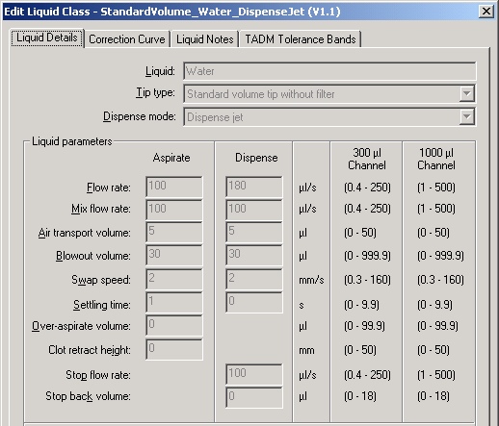

Dispense Modes
Jet Dispense
Surface Dispense

Slide 22
Liquid Parameters 1
    ”Flow rates” and ”Mix flow rates”:
      Volume flow rates in μl/s, corresponding to plunger speed, for aspiration, dispense and mixing.
      Depends on tip geometry, liquid viscosity, density, and vapor pressure.

Slide 23
Liquid Parameters 2
    ”Blowout volume”:
      “Blowout air” in μl is aspirated first during the aspiration step, and dispensed if the dispense mode is ”empty tip”. In the dispense step, the entire volume including blowout air is dispensed.
      Depends on liquid viscosity and vapour pressure.
    ”Air transport volume”:
      “Transport air” in μl is aspirated at the end of the aspiration and dispense steps and automatically dispensed again as an extra volume in the first part of the dispense step. Used to help prevent droplets.
      Depends on tip geometry and liquid vapour pressure.

Slide 24
Liquid Parameters 3
    ”Settling time”:
      Time in s the dispensing head remains in the liquid after the aspirating or dispensing, before moving out of the liquid.
      Depends on tip geometry and liquid viscosity.
    ”Swap speed”:
      Speed in mm/s at which the dispensing head is drawn up out of the liquid.
      Depends on liquid viscosity and vapor pressure.
Δt

Slide 25
Liquid Parameters 4
    ”Over-aspirate volume”:
      A kind of pre-wetting volume in μl. After aspirating the required volume, the over-aspirate volume is aspirated, and then the over-aspirate volume is dispensed again immediately.
      Depends on liquid viscosity and vapor pressure.
    ”Clot retract height”:
      This parameter enables the recognition of blood clots. It determines how high the dispensing head is allowed to move up out of the liquid after aspiration with an active cLLD signal. It is measured in mm from the height of the liquid surface upwards. An error message is generated if this distance is exceeded.
ΔV_{o-a}

Slide 26
Liquid Parameters 5
V(disp)
    ”Stop flow rate”:
      Dispense flow rate in μl/s, at which the dispensing step terminates abruptly.
      Depends on liquid viscosity.
    ”Stop back volume”:
      Volume in μl which is aspirated again immediately after the dispense. This volume is aspirated as quickly as possible.
      Depends on liquid viscosity.
t

Slide 27
Inside the Tip
Aspirate
Dispense
Channel
Channel
1st –
Blowout Air
3rd –
Blowout Air
Tip
Tip
2nd – Liquid
2nd – Liquid
4th – Stop Back Volume
1st - Transport Air (from the aspiration)
5th - Transport Air (Dispense)
3rd – Transport Air

Slide 28
Correction Curves
Determined gravimetrically for optimized liquid parameters
Valid for new tips and washed needles
Correction values can be specified for every volume
Correction curves are often non-linear

Slide 29
Properties
All correction curves
  Start in the origin (0/0)
  Increase monotonically (no up & down)
  Have at least 2 values: (0/0) and (max/max)
  Are unambiguous: one corrected volume for each target volume
  Are interpolated linearly between two corrected values

Slide 30
Aliquotting Example
V_{aliquot} = 75 µl
V_{aspiration}=275 μl =
(3 x 75μl Aliquots) +50
Specify target and corrected volumes for every tip volume in the aliquot process, not necessarily for the aliquot volume itself.
(Target,Corrected)
Corrected Volume
(275,290)
(200,210)
(125,130)
(50,50)
(0,0)
Target Volume

Slide 31
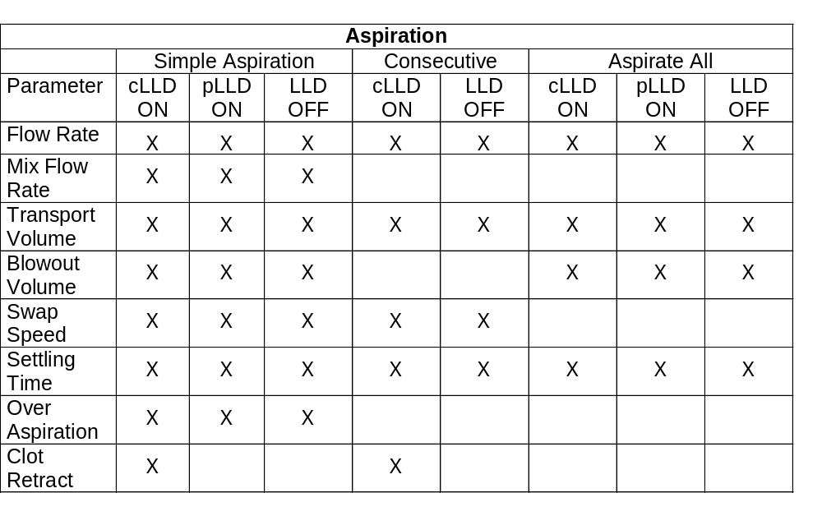
Aspiration Modes

Slide 32
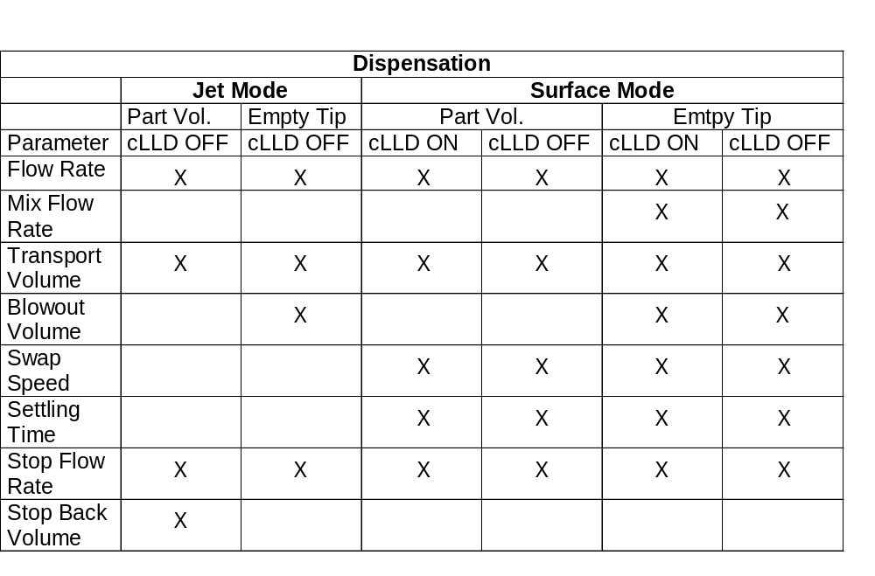
Dispense Modes

Slide 33
Dispense Mode, Mixing and LLD
Dispense mode and LLD:
  Dispense jet: only LLD OFF is allowed
  Dispense surface: LLD ON or OFF
Dispense mode and mixing:
  Mixing is allowed only for “Surface Dispense, Empty Tip”

Slide 34
Combinations of Liquid Class and Dispense Mode
Tip Type Liquid Dispense Mode
Low Glycerin Surface dispense, empty tip
Standard DMSO Jet dispense, empty tip
High Water Jet dispense aliquot, part volume
Examples of available standard combinations for which liquid classes are optimized.
Liquid classes are valid for new tips (or washed needles).

Slide 35
Detailed Example for Often Used Combinations 1/3
Aspirate >20μl of aqueous liquid, dispense into an empty 96 well plate, use standard tips, change tips every cycle:
Liquid class: StandardVolume_Water_DispenseJet
Aspiration mode: (0) Aspiration
Aspiration position: cLLD On with 2mm submerge depth
Dispense mode: (1) Jet dispense empty tip
Dispense position: Fixed height (5mm, LLD Off)

Slide 36
Detailed Example for Often Used Combinations 2/3
Aspirate ≤10μl of aqueous liquid, single dispense into a pre-filled
96 well plate, use low volume tips, change tips every cycle:
Liquid class: LowVolume_Water_DispenseSurface
Aspiration mode: (0) Aspiration
Aspiration position: cLLD On with 1mm submerge depth
Dispense mode: (2) Surface dispense empty tip
Dispense position: cLLD On with 1mm submerge depth

Slide 37
Detailed Example for Often Used Combinations 3/3
Aspirate ≤10μl of aqueous liquid, single dispense into empty 384 well plate, use low volume tips, change tips every cycle:
Liquid class: LowVolume_Water_DispenseJet
Aspiration mode: (0) Aspiration
Aspiration position: cLLD On with 1mm submerge depth
Dispense mode: (1) Jet dispense empty tip
Dispense Position: Fixed height (0.5 mm, LLD Off) „Touch-Off“
If droplet remains on tip, reduce dispense height to 0.2 mm and create new liquid class with blowout volume of 2-5 μl.

Slide 38
Problem / Cause / Solution
(Examples)
Drop formation / long waiting time / method optimization (simultaneous dispense)

Slide 39
Problem / Cause / Solution
(Examples)
Drop formation / long waiting time / method optimization (simultaneous dispense)
… / high vapor pressure / liquid class and method adjustment (pre-wetting, air transport volume)

Slide 40
Problem / Cause / Solution
(Examples)
Drop formation / long waiting time / method optimization (simultaneous dispense)
… / high vapor pressure / liquid class and method adjustment (pre-wetting, air transport volume)
… / high viscosity / liquid class adjustment (swap speed, flow rate)

Slide 41
Problem / Cause / Solution
(Examples)
Drop formation / long waiting time / method optimization (simultaneous dispense)
… / high vapor pressure / liquid class and method adjustment (pre-wetting, air transport volume)
… / high viscosity / liquid class adjustment (swap speed, flow rate)
… / high surface tension / liquid class adjustment (stop flow rate, stop back volume)
…

Slide 42
Aliquot Handling
Aliquoting procedure for N aliquotes of volume V:
- Aspirate (N+2)*V
- Dispense V as pre-aliquot
- Dispense N*V as main aliquotes
- Dispense V as post-aliquot or waste it with the tip

Slide 43
Typical Aliquoting Curve
Volume Dispensed
CV=2-3%
Number of aliquot

Slide 44
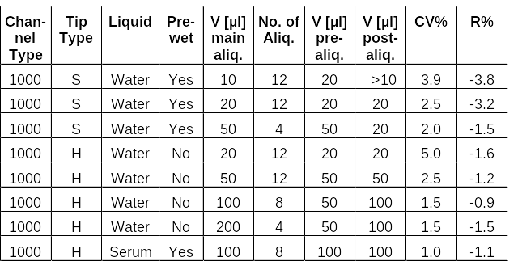
Table of Aliquots
(Examples)

Slide 45
Pipetting Precision
Tip use:
  Good: aliquoting
  Better: multiple aspiration/dispense cycles with the same tip & pre-wetting before first aspiration
  Best: new tips for every step
Surface / jet mode:
  Surface for V < 20μl (first large quantity of buffer, then sample)
Pooling:
  Parallel dispenses for multiple pools to avoid long waiting time and thus droplet formation

Slide 46

Microlab STAR - Accuracy
Pipetting Accuracy with Disposable Tips(T) and Steel Needles(N):
Trueness R = (<V> - V₀) / V₀ * 100%
V₀: target volume, <V>: mean volume of measurement
Precision CV = s / <V> * 100%
s: standard deviation of measurement

Slide 47
Specification
Determined under the following conditions:
  Test solution: water, 0.1% NaCl, 0.01% Tween
  12 measurements per channel
  V < 20μl: surface mode, V ≥ 20μl jet mode
  Tips are changed for each measurement
  Needles are washed
Specifications strongly depend on the liquid. For every liquid they need to be re-determined.

Slide 48
Mixing/Shaking
Extremely important for good precision in
  Dilution series
  All optical assays/tests (fluorescence, absorption, luminescence)
Mixing with tips (asp./disp.)
  Efficient for mix volumes equal to tip volume
  Slow
Shaking with shakers
  Less efficient than mixing, but higher volume possible
  1ml in deep well block, 200μl in flat plates

Slide 49
Pipetting Performance
Aspiration/dispense modes and liquid classes are the major factors determining precision and droplet-free pipetting.
In some cases, additional efforts are necessary, e.g. pre-wetting (Methanol) or Tip Touch-off

Slide 50
Carry-Over
Reduction of carry-over by
  New tips for every step
  Filter tips
  Surface dispenses
  Part volume dispenses

Slide 51
Liquid Class Determination
Pipetting results for 4 liquids and 4 different liquid classes:
standard volume tips, surface dispense, 10 μl

Slide 52

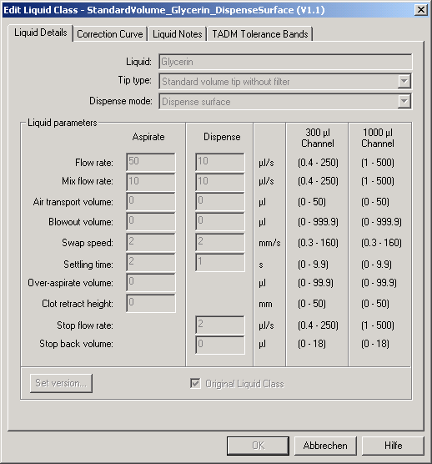
Liquid Class Determination

Slide 53
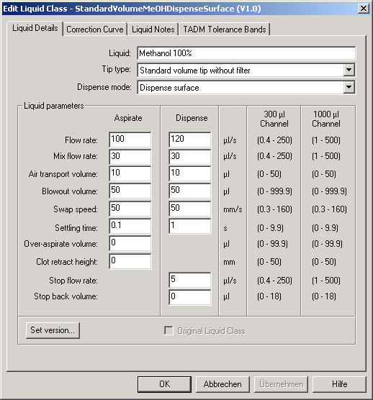
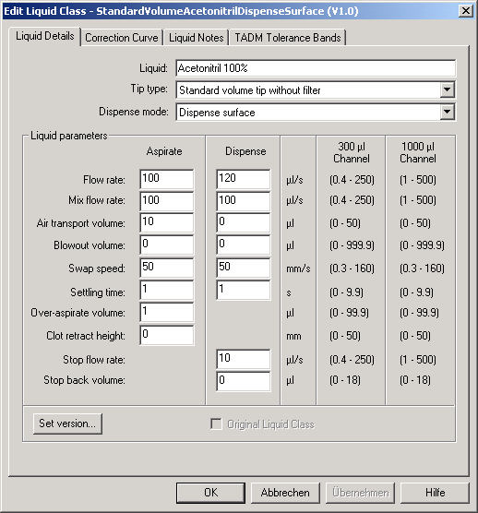
Liquid Class Determination

Slide 54
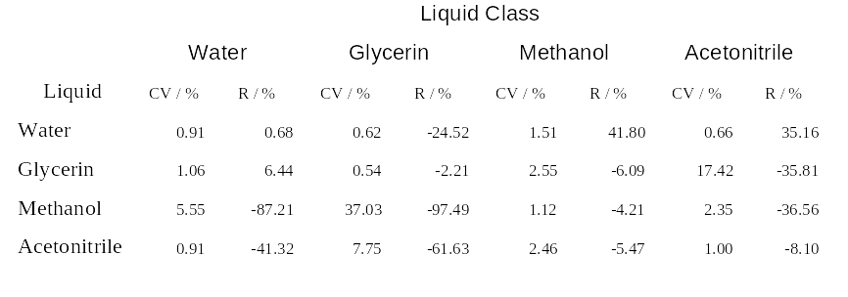
Liquid Class Determination
Pipetting results for 4 liquids and 4 different liquid classes:
standard volume tips, surface dispense, 10 μl
*
#
*: HAMILTON Verification Solution; #: 80%

